Slide 1
EIE 411 Computer Organization and Architecture
MODULE 04 A: STORAGE & INPUT/OUTPUT SYSTEM
Part A: Computer Function & Interrupts

Slide 2
Outline of Module 4
Storage and Input/output Systems:
Computer function
(fetch and execute cycles),
interrupts,
interconnection structures
(Bus structure and bus types)

Slide 3
Practice Questions
*Draw a block diagram of a simple computer machine, indicate the direction of flow and explain the function of each of the components ( Hint: consider only CPU and memory module i.e. Memory, PC, MAR,IR,MBR,ALU,ACC., Read, Write and Ready ).

Slide 4
PART 1
COMPUTER FUNCTIONS

Slide 5
CPU STRUCTURE
CPU must:
Fetch instructions
Interpret instructions
Fetch data
Process data
Write data
Notes:
22
The operation or task that must perform by CPU are:
Fetch Instruction: The CPU reads an instruction from memory.
Interpret Instruction: The instruction is decoded to determine what action is required.
Fetch Data: The execution of an instruction may require reading data from memory or I/O module.
Process data: The execution of an instruction may require performing some arithmatic or logical operation on data.
Write data: The result of an execution may require writing data to memory or an I/O module

Slide 6
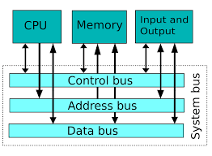

Slide 7
The operation or task that must perform by CPU are:
Fetch Instruction: The CPU reads an instruction from memory.
Interpret Instruction: The instruction is decoded to determine what action is required.
Fetch Data: The execution of an instruction may require reading data from memory or I/O module.
Process data: The execution of an instruction may require performing some arithmatic or logical operation on data.
Write data: The result of an execution may require writing data to memory or an I/O module

Slide 8
CPU
To do these tasks, it should be clear that the CPU needs to store some data temporarily. It must remember the location of the last instruction so that it can know where to get the next instruction. It needs to store instructions and data temporarily while an instruction is beign executed. In other words, the CPU needs a small internal memory. These storage location are generally referred as registers.

Slide 9
CPU
The CPU is connected to the rest of the system through system bus. Through system bus, data or information gets transferred between the CPU and the other component of the system. The system bus may have three components:

Slide 10
TYPES OF BUSES
Data Bus: Data bus is used to transfer the data between main memory and CPU.
Address Bus: Address bus is used to access a particular memory location by putting the address of the memory location.
Control Bus: Control bus is used to provide the different control signal generated by CPU to different part of the system. As for example, memory read is a signal generated by CPU to indicate that a memory read operation has to be performed. Through control bus this signal is transferred to memory module to indicate the required operation.

Slide 11
CPU
There are three basic components of CPU: register bank, ALU and Control Unit. There are several data movements between these units and for that an internal CPU bus is used. Internal CPU bus is needed to transfer data between the various registers and the ALU.
The internal organization of CPU in more abstract level is shown below:

Slide 12
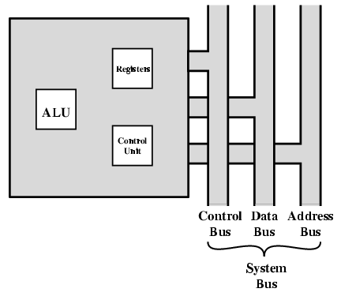
CPU WITH SYSTEMS BUS

Slide 13
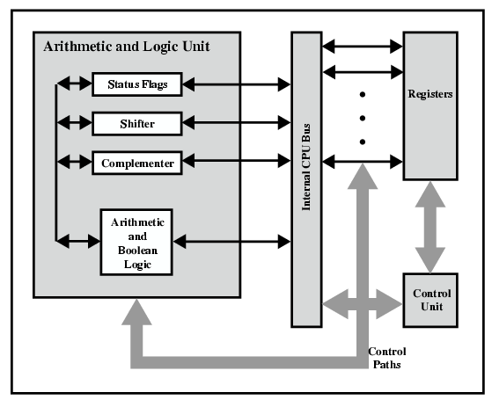
CPU INTERNAL STRUCTURE

Slide 14
REGISTERS
CPU must have some working space (temporary storage)
Called registers
Number and function vary between processor designs
One of the major design decisions
Top level of memory hierarchy
Notes:
23
To do these tasks, it should be clear that the CPU needs to store some data temporarily. It must remember the location of the last instruction so that it can know where to get the next instruction. It needs to store instructions and data temporarily while an instruction is beign executed. In other words, the CPU needs a small internal memory. These storage location are generally referred as registers.

Slide 15
REGISTER ORGANIZATION
A computer system employs a memory hierarchy. At the highest level of hierarchy, memory is faster, smaller and more expensive. Within the CPU, there is a set of registers which can be treated as a memory in the highest level of hierarchy. The registers in the CPU can be categorized into two groups:

Slide 16
REGISTER ORGANIZATION
User-visible registers: These enables the machine - or assembly-language programmer to minimize main memory reference by optimizing use of registers.
Control and status registers: These are used by the control unit to control the operation of the CPU. Operating system programs may also use these in privileged mode to control the execution of program.

Slide 17
USER VISIBLE REGISTERS
General Purpose
Data
Address
Condition Codes
Notes:
24

Slide 18
GENERAL PURPOSE REGISTERS (1)
May be true general purpose
May be restricted
May be used for data or addressing
Data
Accumulator
Addressing
Segment
Notes:
25

Slide 19
GENERAL PURPOSE REGISTERS (2)
Make them general purpose
Increase flexibility and programmer options
Increase instruction size & complexity
Make them specialized
Smaller (faster) instructions
Less flexibility
Notes:
26

Slide 20
HOW MANY GP REGISTERS?
Between 8 - 32
Fewer = more memory references
More does not reduce memory references and takes up processor real estate
Notes:
27

Slide 21
HOW BIG?
Large enough to hold full address
Large enough to hold full word
Often possible to combine two data registers
C programming
double int a;
long int a;
Notes:
28

Slide 22
CONDITION CODE REGISTERS
Sets of individual bits
e.g. result of last operation was zero
Can be read (implicitly) by programs
e.g. Jump if zero
Can not (usually) be set by programs
Notes:
29

Slide 23
CONTROL & STATUS REGISTERS
Program Counter (PC)
(Decoding) Instruction Register (IR)
Memory Address Register (MAR)
Memory Buffer Register (MBR)
Revision: what do these all do?
Notes:
30

Slide 24
Register Organization
There are a variety of CPU registers that are employed to control the operation of the CPU. Most of these, on most machines, are not visible to the user.
Different machines will have different register organizations and use different terminology. We will discuss here the most commonly used registers which are part of most of the machines.

Slide 25
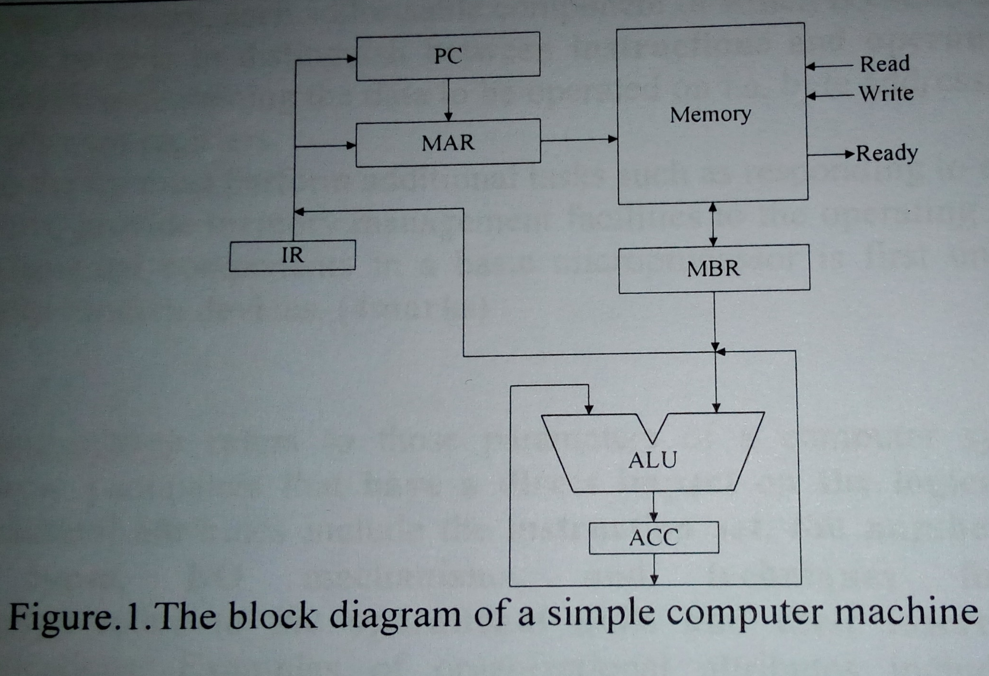

Slide 26
Four registers are essential to instruction execution:
Program Counter (PC):
Contains the address of an instruction to be fetched. Typically, the PC is updated by the CPU after each instruction fetched so that it always points to the next instruction to be executed. A branch or skip instruction will also modify the contents of the PC.
It identifies the address of the instruction to be executed. Usually this register is incremented by during the execution of current instruction.

Slide 27
Four registers are essential to instruction execution
Instruction Register (IR):
Contains the instruction most recently fetched. The fetched instruction is loaded into an IR, where the op-code and operand specifies are analyzed.
The IR is used to store the instruction currently being executed. This allows the control portion of the machine to assert the control line of the register, memory and ALU to cause the action needed.

Slide 28
Four registers are essential to instruction execution:
Memory Address Register (MAR):
Contains the address of a location of main memory from where information has to be fetched or information has to be stored. A content of MAR is directly connected to the address bus.
This collection of storage element has the responsibility to identifying the memory location of information to be read or written.

Slide 29
Four registers are essential to instruction execution:
Memory Buffer Register (MBR):
Contains a word of data to be written to memory or the word most recently read. Contents of MBR is directly connected to the data bus. It is also known as Memory Data Register(MDR).
It is used to store information moved into and out of memory.

Slide 30
A Register (Accumulator) = ACC
This is a general-purpose register which serves for storing intermediate results while operating. Prior to perform an instruction on a number (operand), it first should be added to the accumulator. Once the ALU performed an arithmetical operation, the result is added to the accumulator. Prior to be transferred from one register to another, the data must go through the accumulator. For such universal purpose, this is the most commonly used register.

Slide 31
Four registers are essential to instruction execution:
Apart from these specific register, we may have some temporary registers which are not visible to the user. As such, there may be temporary buffering registers at the boundary to the ALU; these registers serve as input and output registers for the ALU and exchange data with the MBR and user visible registers.

Slide 32

A Register (Accumulator) = ACC
The register is the receptacle of action of all the data manipulation instruction.

Slide 33
Register versus memory:
A machine must have registers so that data can be brought into the CPU for processing. With a single user-visible register (usually called the accumulator), one operand address is implicit and consumes no instruction bits. Even with multiple registers, only a few bits are needed to specify the register. The more that registers can be used for operand references, the fewer bits are needed

Slide 34
Processor Status Word (PSW)
All CPU designs include a register or set of registers, often known as the processor status word (PSW), that contains status information. The PSW typically contains condition codes plus other status information. Common fields or flags include the following:

Slide 35
Processor Status Word (PSW)
A set of bits
Includes Condition Codes
Sign of last result
Zero
Carry
Equal
Overflow
Interrupt enable/disable
Supervisor
Notes:
31

Slide 36
Processor Status Word (PSW)
Sign: Contains the sign bit of the result of the last arithmatic operation.
Zero: Set when the result is zero.
Carry: Set if an operation resulted in a carry (addition) into or borrow (subtraction) out of a high order bit.
Equal: Set if a logical campare result is equal.

Slide 37
Processor Status Word (PSW)
Overflow: Used to indicate arithmatic overflow.
Interrupt enable/disable: Used to enable or disable interrupts.
Supervisor: Indicate whether the CPU is executing in supervisor or user mode. Certain privileged instructions can be executed only in supervisor mode, and certain areas of memory can be accessed only in supervisor mode.

Slide 38
OTHER REGISTERS
May have registers pointing to:
Process control blocks (see O/S)
Interrupt Vectors (see O/S)
N.B. CPU design and operating system design are closely linked
Notes:
33

Slide 39
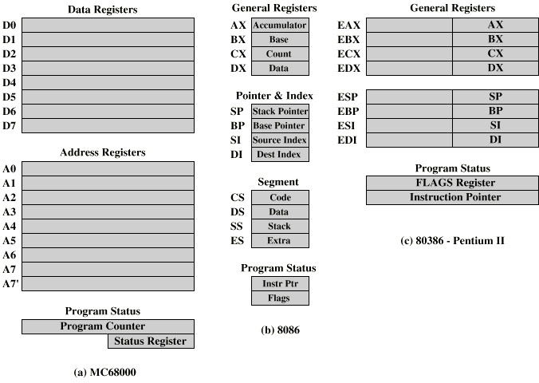
Example Register Organizations

Slide 40
INDIRECT CYCLE
May require memory access to fetch operands
Indirect addressing requires more memory accesses
Can be thought of as additional instruction subcycle

Slide 41
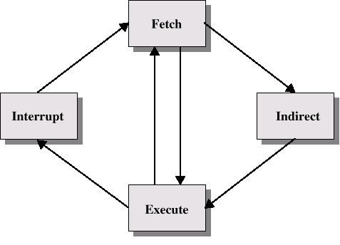
Instruction Cycle with Indirect

Slide 42
Data Flow (Instruction Fetch)
Depends on CPU design
In general:
Fetch
PC contains address of next instruction
Address moved to MAR
Address placed on address bus
Control unit requests memory read
Result placed on data bus, copied to MBR, then to IR
Meanwhile PC incremented by 1

Slide 43
Data Flow (Data Fetch)
IR is examined
If indirect addressing, indirect cycle is performed
Right most N bits of MBR transferred to MAR
Control unit requests memory read
Result (address of operand) moved to MBR

Slide 44
Concept of Program Execution
For simplicity, let us assume that each instruction occupies one memory word. Therefore, execution of one instruction requires the following three steps to be performed by the CPU:
1. Fetch the contents of the memory location pointed at by the PC. The contents of this location are interpreted as an instruction to be executed. Hence, they are stored in the instruction register (IR). Symbolically this can be written as: IR = [ [PC] ]

Slide 45
Concept of Program Execution
2. Increment the contents of the PC by 1. PC = [PC] + 1
3. Carry out the actions specified by the instruction stored in the IR.
The first two steps are usually referred to as the fetch phase and the step 3 is known as the execution phase. Fetch cycle basically involves read the next instruction from the memory into the CPU and along with that update the contents of the program counter.

Slide 46
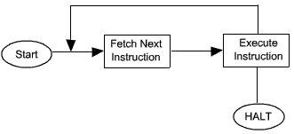
Concept of Program Execution
In the execution phase, it interpretes the opcode and perform the indicated operation. The instruction fetch and execution phase together known as instruction cycle. The basic instruction cycle is shown in the
Basic Instruction cycle

Slide 47
Concept of Program Execution
In cases, where an instruction occupies more than one word, step 1 and step 2 can be repeated as many times as necessary to fetch the complete instruction. In these cases, the execution of a instruction may involve one or more operands in memory, each of which requires a memory access. Further, if indirect addressing is used, then additional memory access are required.

Slide 48
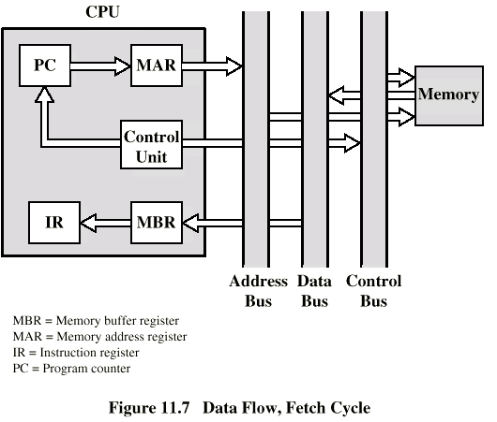
Data Flow (Fetch Diagram)

Slide 49
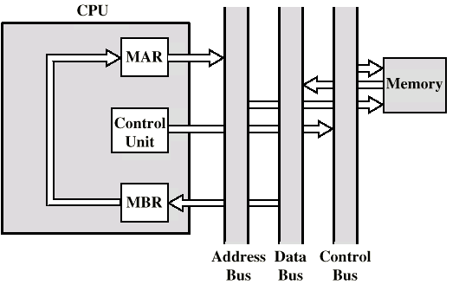
Data Flow (Indirect Diagram)

Slide 50
Data Flow (Execute)
May take many forms
Depends on instruction being executed
May include
Memory read/write
Input/Output
Register transfers
ALU operations

Slide 51
Data Flow (Interrupt)
Simple
Predictable
Current PC saved to allow resumption after interrupt
Contents of PC copied to MBR
Special memory location (e.g. stack pointer) loaded to MAR
MBR written to memory
PC loaded with address of interrupt handling routine
Next instruction (first of interrupt handler) can be fetched

Slide 52
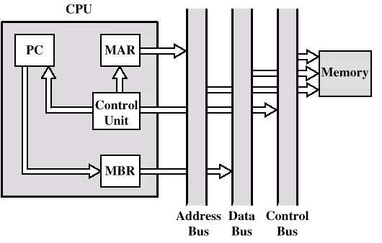
Data Flow (Interrupt Diagram)

Slide 53
PRE-FETCH
Fetch accessing main memory
Execution usually does not access main memory
Can fetch next instruction during execution of current instruction
Called instruction pre-fetch
Notes:
36

Slide 54
IMPROVED PERFORMANCE
But not doubled:
Fetch usually shorter than execution
Prefetch more than one instruction?
Any jump or branch means that pre-fetched instructions are not the required instructions
Add more stages to improve performance
Notes:
37

Slide 55
PART 2
INTERRUPTS

Slide 56
COMPUTER ARCHITECTURE (REVIEW)
Computer Architecture is the field of study of selecting and interconnecting hardware components to create computers that satisfy functional performance and cost goals. It refers to those attributes of the computer system that are visible to a programmer and have a direct effect on the execution of a program.
Computer Architecture concerns Machine Organization, interfaces, application, technology, measurement & simulation that Includes:
Instruction set
Data formats
Principle of Operation (formal description of every operation)
Features (organization of programmable storage, registers used, interrupts mechanism, etc.)
In short, it is the combination of Instruction Set Architecture, Machine Organization and the related hardware.

Slide 57
COMPUTER ORGANIZATION (REVIEW)
If computer architecture is a view of the whole design with the important characteristics visible to programmer, computer organization is how features are implemented with the specific building blocks visible to designer, such as control signals, interfaces, memory technology, etc. Computer architecture and organization are closely related, though not exactly the same.
A stored program computer has the following basic units:
Processor -- center for manipulation and control
Memory -- storage for instructions and data for currently executing programs
I/O system -- controller which communicate with "external" devices: secondary memory, display devices, network
Data-path & control -- collection of parallel wires, transmits data, instructions, or control signal

Slide 58
COMPUTER ORGANIZATION (REVIEW)
Computer organization defines the ways in which these components are interconnected and controlled. It is the capabilities and performance characteristics of those principal functional units. Architecture can have a number of organizational implementations, and organization differs between different versions. Such, all Intel x86 families share the same basic architecture, and IBM system/370 family share their basic architecture.

Slide 59
Handling of Interrupts & Exceptions
Instruction set architecture - ISA refers to the actual programmer visible machine interface such as instruction set, data representation, addressing, registers, memory organization and exception (i.e. interrupt) handling.
One can think of a ISA as a hardware functionality of a given computer.
A computer organization and computer hardware are two components of the implementation of a machine.

Slide 60
INTERRUPTS CLASSES
There are three classes of causes for an interrupt.
• Power failure
• Memory parity error
1. Interrupts caused by hardware failure:
2. Interrupts caused by external signals:
• Reset: A signal asserted on the appropriate pin;
Hardware Interrupts: Interrupt requests made via asserting signal on any of special external pins.
-Interrupt request lines – IRQ’s.
- Usually used by I/O controllers to signal normal I/O completion or a variety of error conditions. These interrupts also called I/O interrupts.

Slide 61
INTERRUPTS CLASSES
3. Interrupts as result of instruction execution (these are also called exceptions); There are two types of those interrupts:
Type A caused by problems during instruction execution:
– Address Error: a reference to a nonexistent or illegal memory address;
– Reserved Instruction: An instruction with undefined opcode field or a privileged instruction in User mode;
– Integer division by zero
– Floating Point Error
Type B caused by special instructions:
– MIPS processors: Syscall or any trap instruction executed;
– Intel processors: INT n instruction executed;

Slide 62
CPU Modes and Memory Address Space: Interrupt Handling
• There are two modes MIPS CPU can operate in:
– kernel mode and
– user mode.
• The processor enters Kernel Mode at power-up, or as result of an interrupt or exception.
• The processor leaves Kernel Mode and enters User Mode when ERET instruction is executed.
• Memory address space is divided in two ranges (simplified):
-User address space: address range [0 – 7FFFFFFF16]
-Kernel address space: address range [8000000016 – FFFFFFFF16]

Slide 63
Dual-Mode of CPU Operation
• CPU mode bit in Status register indicate the current CPU
-mode: 0 (=kernel) or 1 (=user).
• When an interrupt occurs, CPU hardware switches to the kernel mode.
• Switching to user mode (from kernel mode) done by setting
-CPU mode bit ERET instruction.

Slide 64
DUAL-MODE OF CPU OPERATION

Slide 65
MIPS Privilege Instructions
With CPU in User Mode, the program in execution has access only to the CPU and FPU registers, while when CPU operates in Kernel Mode, the program has access to the full capabilities of processor including CP0 registers.
Examples of MIPS privileged instructions:
any instruction that accesses Kernel address space,
instructions that access CP0 registers, e.g. MFC0 and MTC0,
ERET instruction.
-Privileged instructions will not be executed when the processor is in User mode and they will be considered (by CPU) as instructions with illegal op code.

Slide 66
MIPS Interrupt Processing
• When any of the interrupts previously listed occurs, hardware should perform some predefined (by its ISA) tasks.
• MIPS, for instance, does hardware interrupt processing in three steps:
Step 1. (Saving content of PC)
• EPC register gets a value equal to either:
– the address of a faulty instruction if the instruction itself caused problems (e.g. address error, reserved instruction) or hardware malfunctioning detected (e.g. memory parity error),
– the address of the next instructions which would have been executed in all other cases, i.e. for interrupts caused by external causes or by those interrupt causing instructions.

Slide 67
MIPS Interrupt Processing
Step 2. (PC gets new value and interrupt cause code is saved)
Step 3. (Mode of CPU operation set to kernel mode)
• PC 8000018016
• CPU mode bit 0;
Thus, the next instruction is fetched from location 8000018016
• Cause register a code of the interrupt

Slide 68
MIPS Interrupt Processing
Each interrupt has its code, e.g.:
– hardware interrupt = 0
– address error exception (load/fatch or store) = 4 or 5
– bus error exception (fetch or load/store)= 6 or 7
– syscall execution = 8
– illegal op-code or reserved instruction exception= 10
– trap exception
– floating point exception = 15

Slide 69
Hardware Interrupt Processing in General
Hardware interrupt processing first saves the address of the interrupted instruction.
Intel x-86 architecture uses a system stack (in memory) to save the address, while in MIPS architecture, EPC register is used.
Hardware interrupt processing then loads PC with the new address.
In Intel x-86 architecture, new content of PC comes from one of special memory locations (interrupt vectors).
Each interrupt has its specific vector address, built in the hardware as a part of ISA.
In MIPS architecture, PC always gets the value 8000018016, while Cause register indicates a type of interrupt or exception.
•Hardware interrupt processing sets CPU into kernel mode.

Slide 70
Operation System and Hardware Interrupt Processing
During booting of operating system, interrupt handling routines are loaded starting at the some memory locations.
It is the responsibility of the operating system to also load interrupt vectors with addresses of the interrupt handling routines.
In MIPS architecture, the operating system code must start at memory address 8000018016, and then based on the content of Cause register appropriate processing is performed.
Hardware interrupt processing saves the address of the interrupted instruction so the interrupted program (if needed) may be later restarted at the point of interruption.
Note that new incoming interrupts may be disabled, i.e. masked, while another interrupt is being processed to prevent a loss of interrupt.

Slide 71
Pentium Interrupt Processing
Interrupts
Maskable
Nonmaskable
Exceptions
Processor detected
Programmed
Interrupt vector table
Each interrupt type assigned a number
Index to vector table
256 * 32 bit interrupt vectors
5 priority classes

Slide 72
Exception Defined
An exception is an unplanned event generated by the CPU.
Examples include: trap or breakpoint instruction, divide by zero, floating point or integer overflow, illegal instruction, or address error.
An exception will generate an “internal” interrupt.

